Slide 1


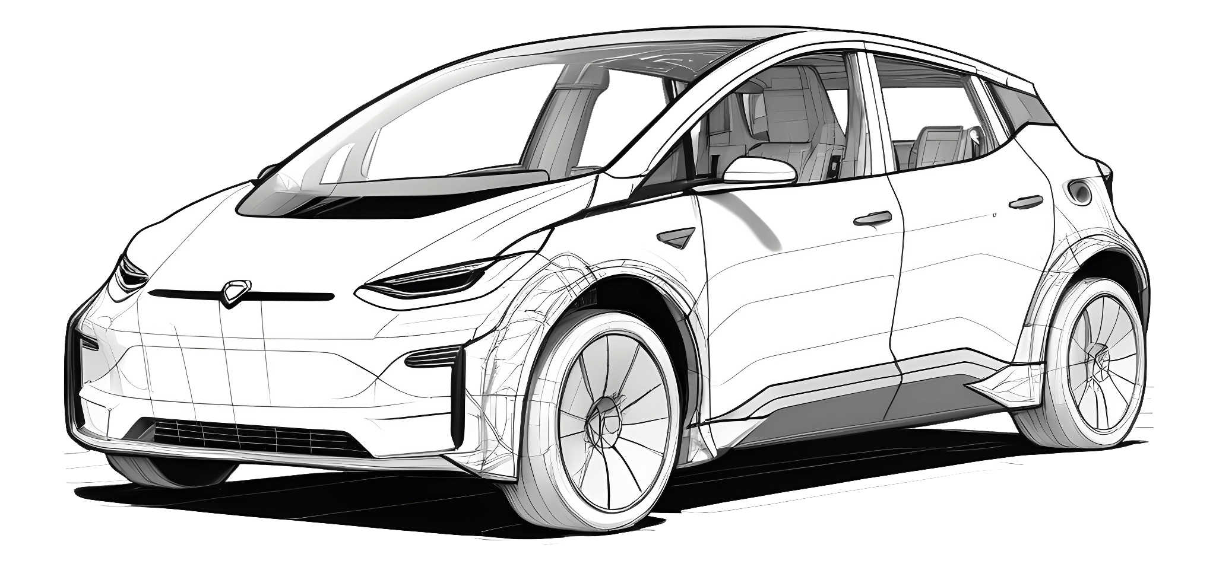
Automated Vehicle Number Plate Detection and Recognition using YOLOv8.
4th International Conference on Electrical, Computer and Communication.
Paper ID: 1092
Abdullah Al Noman
Daffodil International University, Dhaka, Bangladesh.

Slide 2
Contents
Introduction | Easy-OCR Framework
Objectives | Results & Discussions
Literature Review | Conclusion
Methodology | Acknowledgments
Dataset and Preprocessing | Questions
YOLOv8 Model

Slide 3
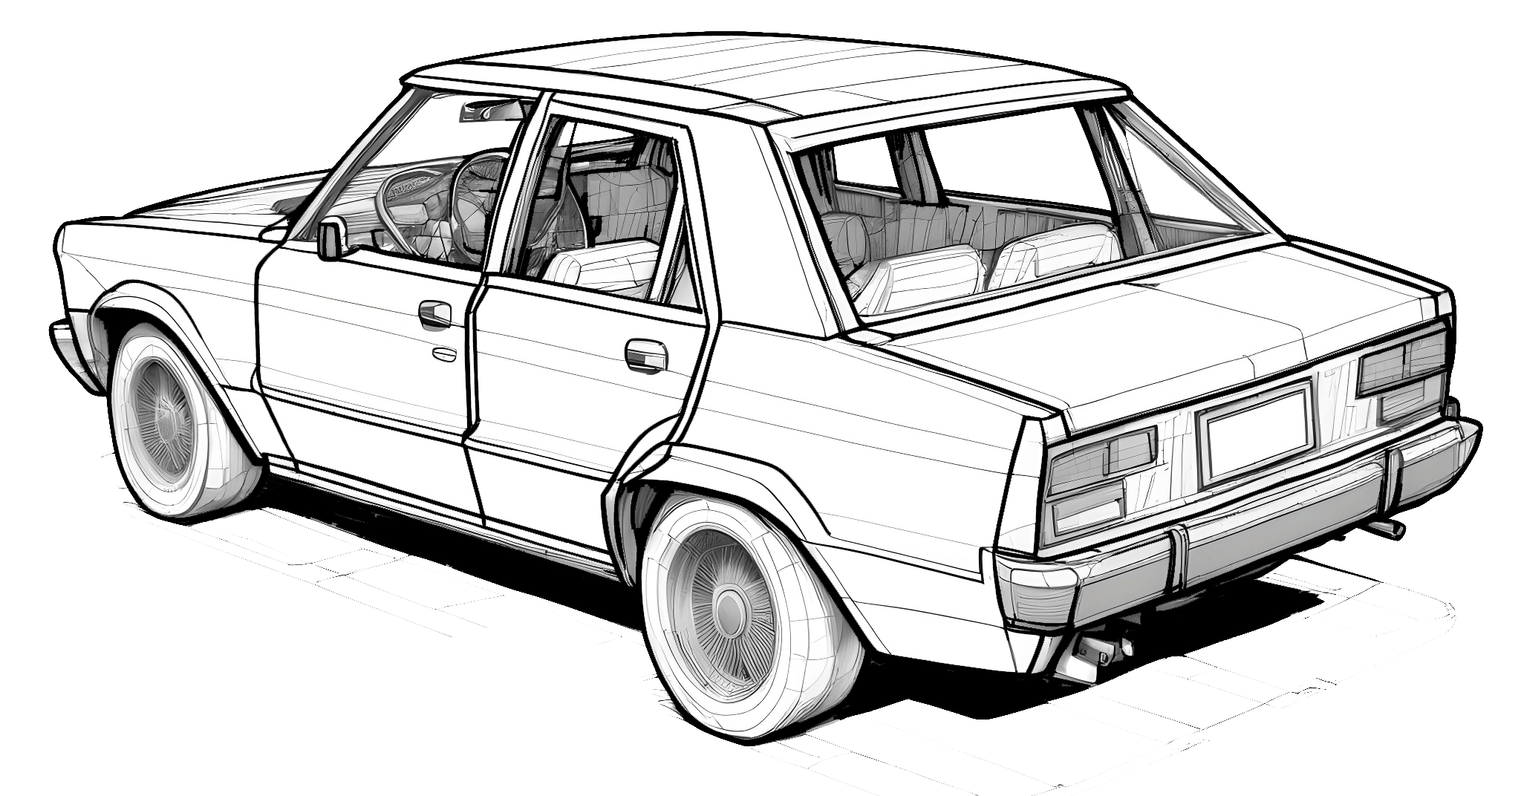
Introduction
01

Slide 4
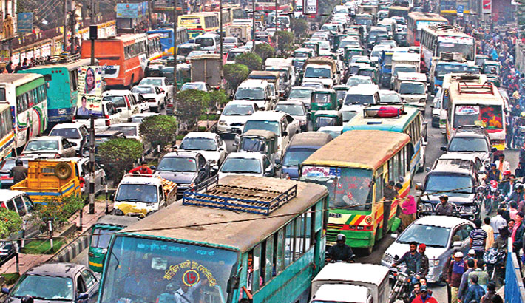
Introduction
01
Problem Statement
Challenges
02
Fast urbanization of Bangladesh really causes heavy traffic congestion as well as poor law enforcement.
Automated license plate recognition is important for toll collection, parking management, and traffic surveillance.
Multilingual Bangla-English plates.
Skewed angles, varying lighting, and noisy inputs.

Slide 5
02
Objective

Slide 6

Objectives
01
Primary Goal
02
Key Objectives
Create a system for real-time detection and recognition of Bangla vehicle license plates.
Develop a custom dataset for Bangla license plates.
Integrate YOLOv8 for detection and Easy-OCR for recognition.
Achieve high accuracy in detection and recognition under challenging conditions.

Slide 7
03
Literature Review

Slide 8
Literature Review
Key Findings from Existing Works
Most systems focus on Latin-based plates, not Bangla.
The challenges include poor lighting, skewed plate, and impending noise pollution.
Our Contribution
Custom dataset for Bangla plates.
Integration of YOLOv8 and Easy-OCR for superior performance.
Gaps in Research
Limited datasets for Bangla license plates.
Lack of robust systems for multilingual scripts.

Slide 9
04
Methodology

Slide 10
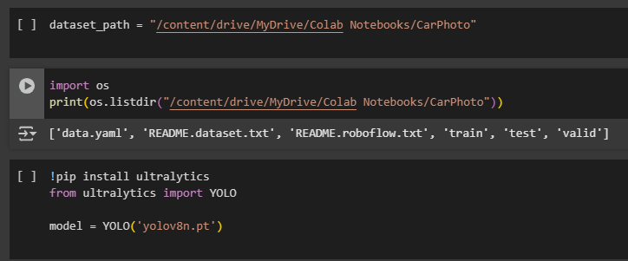
Overview
YOLOv8 for license plate detection.
Easy-OCR for character recognition.

Slide 11
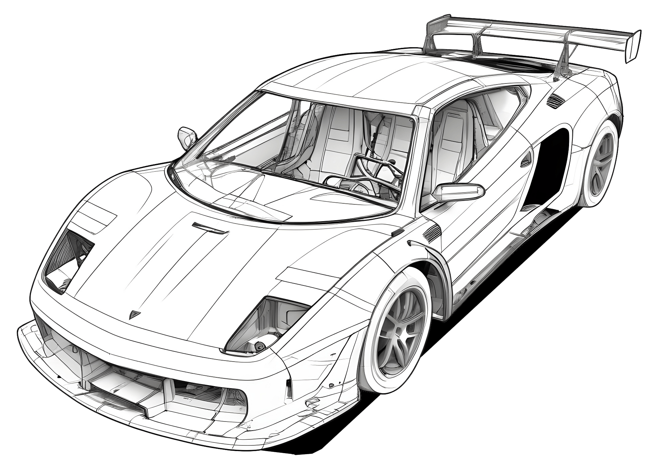
Workflow
Detection (YOLOv8)
Preprocessing
Recognition (Easy-OCR).
Image acquisition

Slide 12
Key Features
Real-time processing.
Robustness to skewed plates, occlusions, and varying lighting.

Slide 13
05
Dataset and Preprocessing

Slide 14
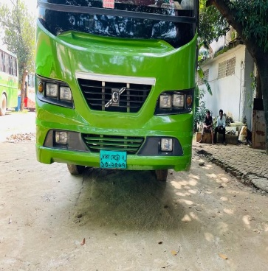
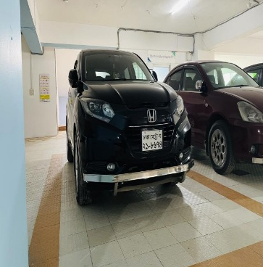
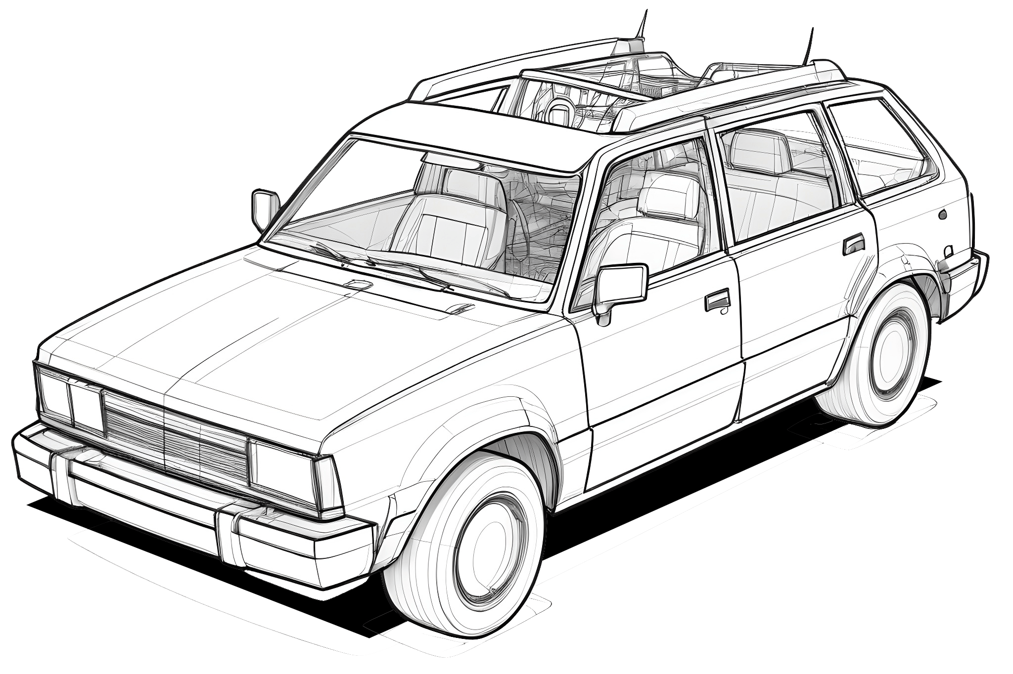
Dataset and Preprocessing
Dataset
Preprocessing
393 images (276 training, 79 validation, 38 testing).
Collected from Dhaka city, focusing on diverse vehicle types and plate designs.
Resizing, cropping, noise removal.
Annotation using Roboflow.
Data augmentation: flipping, rotation, contrast adjustments.

Slide 15
06
YOLOv8 -Model

Slide 16
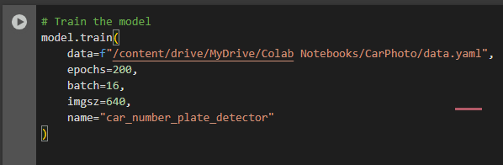
YOLOv8 Model
Architecture
Training Details
CSPNet backbone, FPN/PAN neck, anchor-free detection head.
200 epochs, batch size 16, learning rate 0.01.
High detection accuracy (93–96%).
Real-time processing capabilities.
Key Advantages

Slide 17
07
Easy-OCR Framework

Slide 18
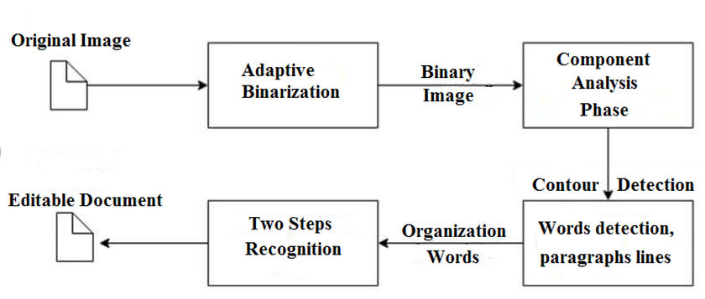
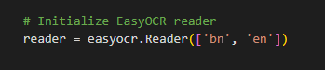
Easy-OCR Framework
Overview
Process
Multilingual OCR framework for Bangla and English scripts.
Adaptive binarization → Component analysis → Character segmentation → Text recognition.
Handles varying fonts, irregular spacing, and partial occlusions.
Achieves low CER (1.52%) and WER (5.53%).
Key Advantages

Slide 19
08
Results & Discussions

Slide 20
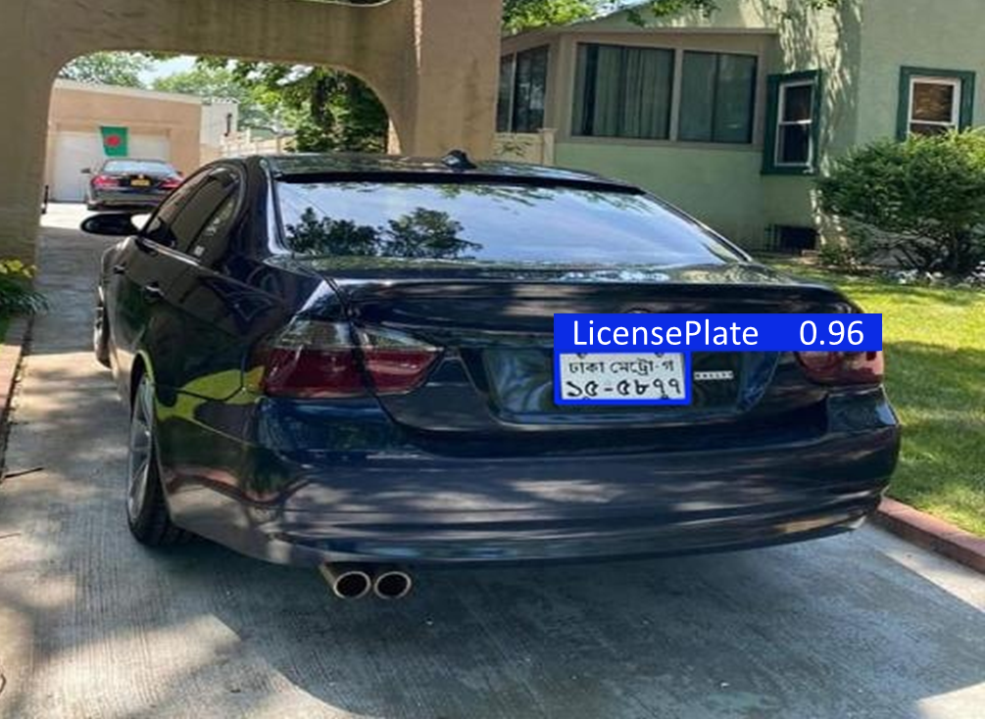
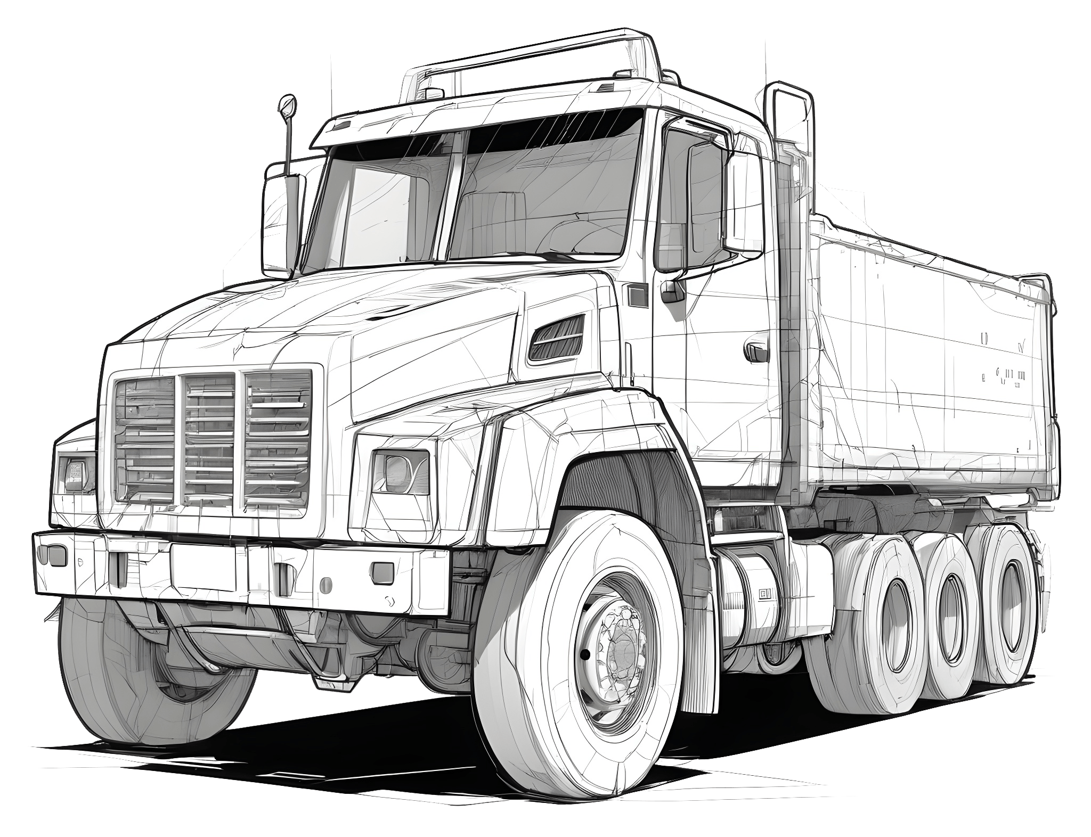
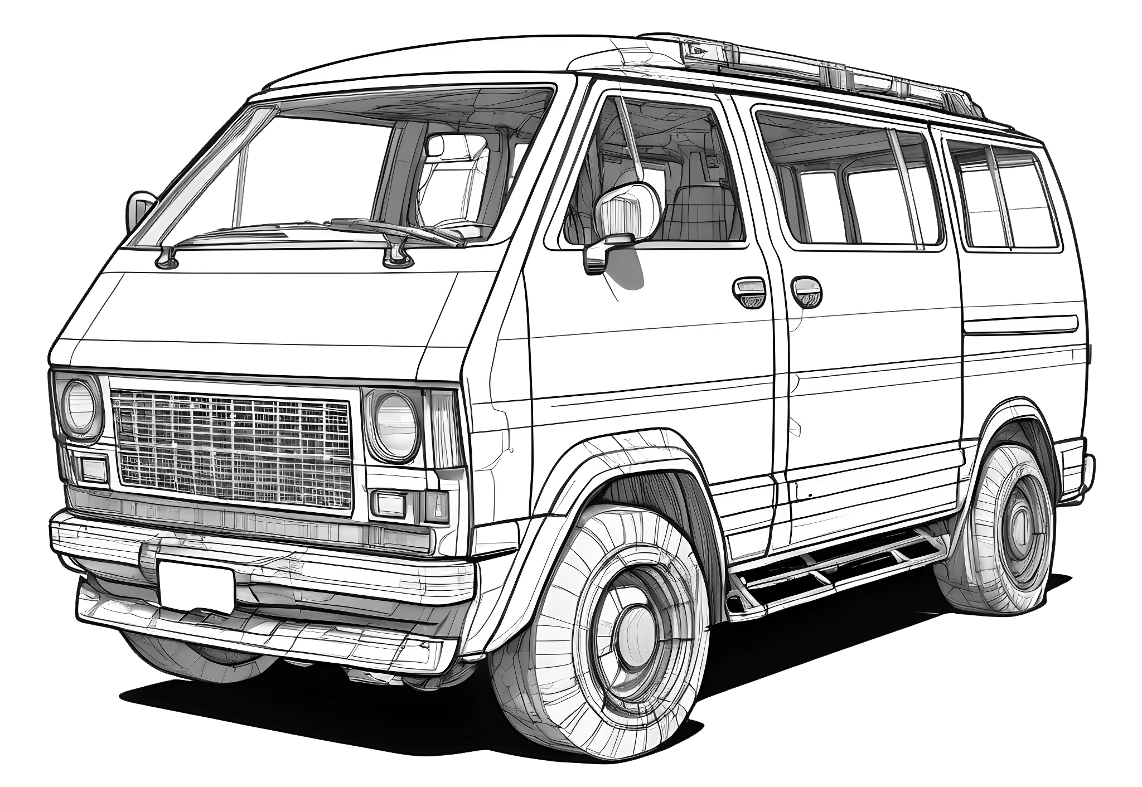
Results & Discussions
Detection Accuracy
93–96% accuracy in detecting Bangla/English license plates.
Recognition Performance
CER: 1.52%, WER: 5.53%.
Comparison with Baseline
Outperforms YOLOv4 + Tesseract (88.5% accuracy, 5.10% CER, 12.50% WER).
Visual Results
Showcase detected plates under varying conditions (skewed, occluded, low lighting).

Slide 21
09
Conclusion

Slide 22
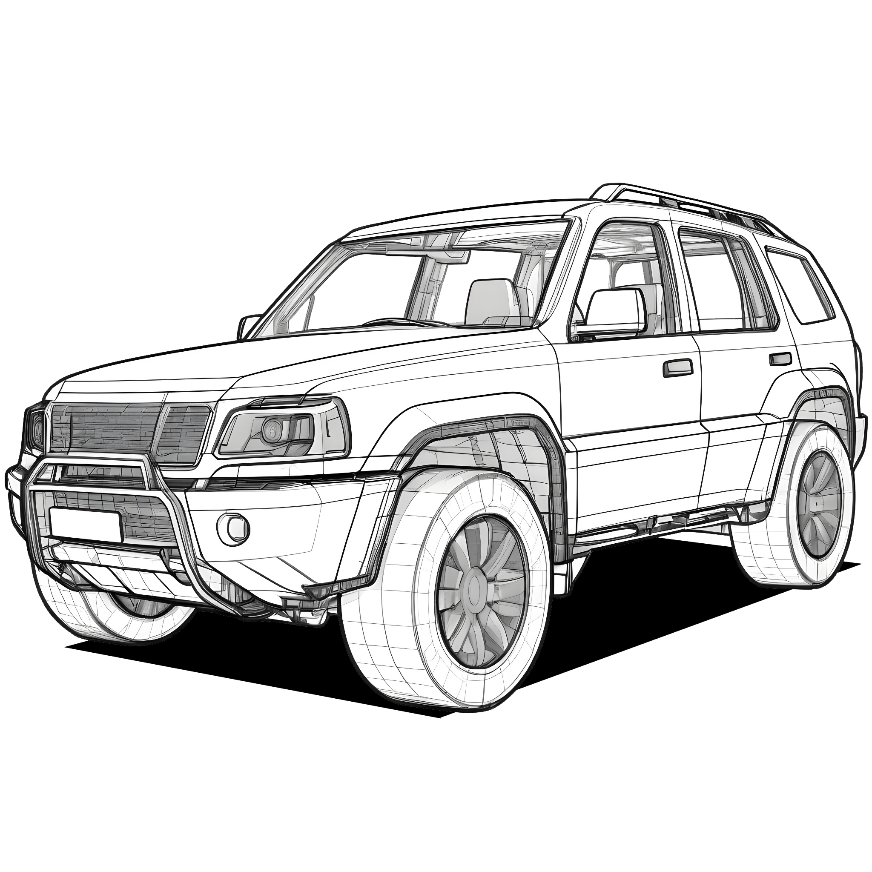
Conclusion
Key Contributions
Applications
Custom dataset for Bangla license plates.
High detection and recognition accuracy.
Robust performance in real-world conditions.
Automated toll collection, parking management, traffic monitoring.
Improve recognition accuracy under challenging conditions.
Enhance generalization for diverse plate formats.
Owner Identification and Low enforcement.
Future Work

Slide 23
Thanks!
Collaborators and Advisors:
Md. Hasan Imam Bijoy (Daffodil International University) for his invaluable guidance and support throughout this research.
My teammates, Abrar Hameem Bornil and Nushrat Jahan Mila, for their dedication and contributions to this research.
Institutions:
Daffodil International University (DIU) for providing the resources and infrastructure necessary for this research.
Conference Organizers:
The organizers of the 4th International
Conference on Electrical, Computer and
Communication Engineering (ECCE) for
providing this platform to present our work.

Slide 24

Any Questions

